Slide 1
Artificial Intelligence in the Battle against COVID-19: A Survey and Future Research Directions
Thanh Thi Nguyen
Presented By:
Aman Choudhary

Slide 2
Overview
Medical Image Processing
AI in Computational Biology and Medicine
Drones to combat covid-19
Risk assessment using AI-based methods
Using NLP for Sentiment Analysis, Data Mining

Slide 3
Medical Image Processing with Deep Learning

Slide 4
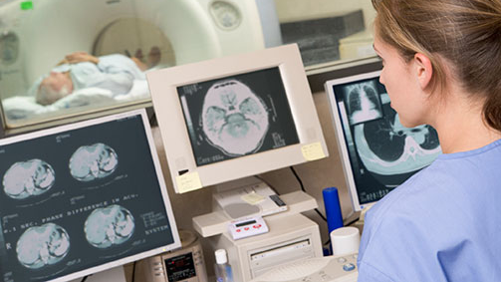
Issues with manual diagnosis
Radiologists and clinical doctors have been using chest CT examinations for diagnosis of COVID-19 cases.
With sky-rocketing cases, this manual effort consumes lot of time.
Prone to human error
AI methods, especially deep learning, have been used to process and analyze medical imaging data to support radiologists and doctors to improve diagnosis performance.

Slide 5
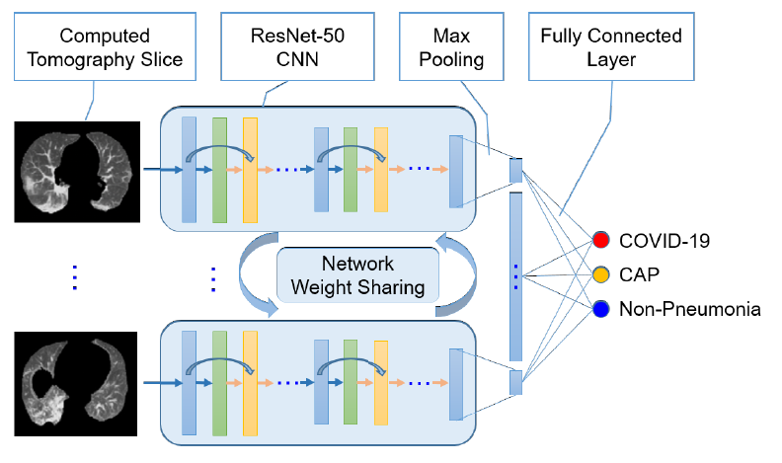
A three-dimensional convolutional ResNet-50 model is used to detect COVID-19 based on volumetric chest CT images.
Three kinds of CT images, including COVID-19, community acquired pneumonia (CAP) and other non-pneumonia cases, are mixed to test the robustness of the proposed model.
COVNet takes a series of CT slices as inputs and predicts the class labels of the CT images via its outputs.
The AUC value (area under the receiver operating characteristic curve, measure of the usefulness of a test) obtained is at 0.96, which shows a great ability of the proposed model for detecting COVID-19 cases.

Slide 6
AI in Computational Biology and Medicine

Slide 7
Protein structure prediction
Protein structure prediction aims to determine the 3-dimensional shape of a protein from its amino acid sequence .
This problem is of fundamental importance to biology as the structure of a protein largely determines its function, but can be hard to determine experimentally.
Google is using their protein structure prediction system, namely AlphaFold, to predict structures of several proteins associated with COVID-19.
It is expected that these predictions will help understand how the coronavirus functions and potentially lead to future development of therapeutics against COVID-19.

Slide 8
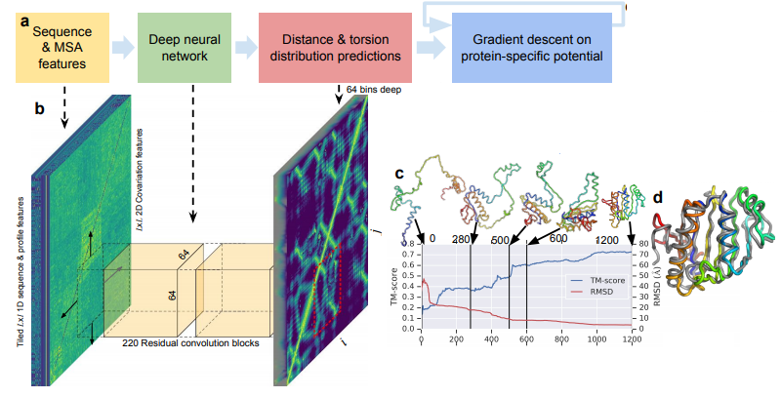
Using the amino acid sequence, the convolutional neural network predicts backbone torsion angles and pairwise distances between residues.
The predicted distributions can be combined to form a simple, principled protein-specific potential.
Using gradient descent, it is simple to find a set of torsion angles that minimize this protein-specific potential.

Slide 9

Detecting origin of Covid-19
Researchers have used AI-based clustering methods over more than 300 genome sequences to search for the origin of the COVID-19 virus.
Numerous clustering experiments are performed on datasets that combine sequences of the COVID-19 virus and those of reference viruses of various types.
Results obtained show that COVID-19 virus genomes consistently form a cluster with those of bat and pangolin coronaviruses.
That provides quantitative evidences to support the hypotheses that bats and pangolins may have served as the hosts for the COVID-19 virus.

Slide 10
Drones to combat covid-19

Slide 11
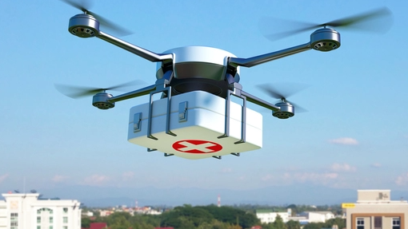
Drones to combat covid-19
Transportation:
Deployed by 18 countries so far to fight covid.
Collection of lab samples, deliver regular medical commodities.
Reduces the transportation time, minimize the exposure to infection.
Aerial spraying:
Sanitization of public outdoor spaces, using drones by aerial spraying of disinfectants.
Public space monitoring and guidance:
Surveillance of public spaces to reduce exposure of law enforcement workers.
Sending messages over a loudspeaker to raise awareness and enforce quarantine.

Slide 12
Predicting the infection risk using data obtained from smartphones sensors

Slide 13
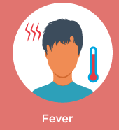


Collecting data & recognizing symptoms
Temperature-fingerprint sensor can be used for fever level prediction
Images and videos taken by smartphones’ camera or data collected by the onboard inertial sensors can be used for human fatigue detection.
Alternatively, audio data obtained from smartphone’s microphone are used for cough type detection.
Various machine learning methods are employed for learning about the disease symptoms based on the collected data.

Slide 14
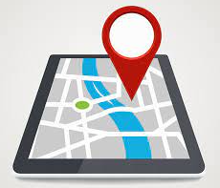
Predicting infection risk
In addition to monitoring symptoms, individuals’ basic travel history can also be monitored.
These data are valuable for predicting the infection risk of each individual, thus help to early identify high-risk cases for quarantine purpose.

Slide 15
Community-level risk assessment using AI-based methods

Slide 16
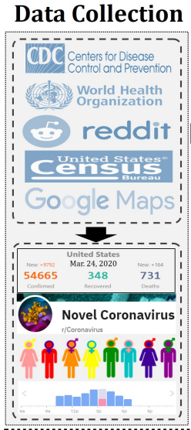
Data collection
An AI-based system, is proposed in to assess the infectious risk of a given geographical area at community levels.
The system collects various types of large-scale and real-time data from heterogeneous sources, such as:
number of cases and deaths
demographic data (population, density, age, sex composition),
traffic density
social media data

Slide 17
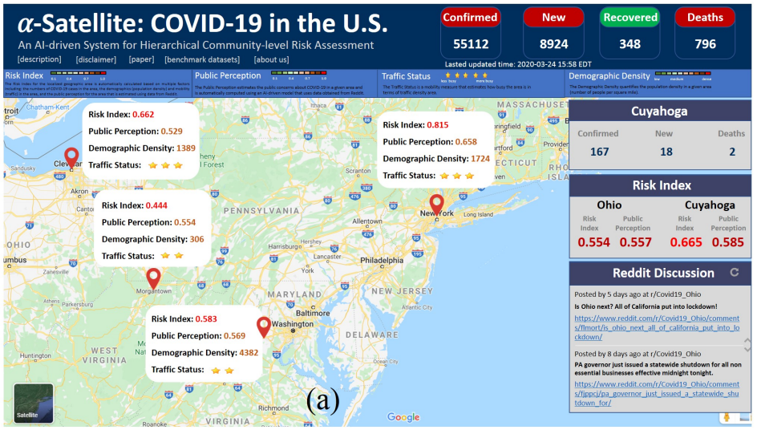

Slide 18
Better preparedness
A heterogeneous information network is constructed, where geographical area is modeled as a node in graph.
AI techniques like graph autoencoder model is then used to aggregate information propagated from its neighborhood nodes.
Finally, risk indexes are estimated for an area.
This risk information enables residents to be more prepared, take appropriate actions to prevent them from the virus infection with minimum disruptions in their daily lives.
It is also useful for authorities to implement appropriate mitigation strategies to combat the fast evolving pandemic.

Slide 19
Using NLP (Natural Language Processing)

Slide 20

NLP (Natural Language Processing)
NLP, is a branch of artificial intelligence that deals with the interaction between computers and humans using the natural language.
The ultimate objective of NLP is to read, decipher, understand, and make sense of the human languages in a manner that is valuable.
Email filters (Spam detectors, Email Classifier - primary, social, or promotions)
Smart assistants (Siri, Cortana)

Slide 21
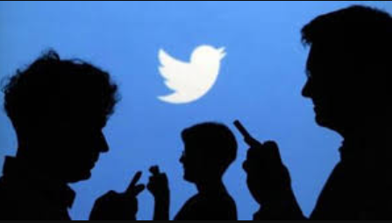
Sentiment Analysis
Since the beginning of the pandemic, governments of many countries have tried to implement policies to mitigate the spread of the virus.
When stricter policies are applied, people’s lives are changed considerably and part of that can be observed and captured via people’s reflections on social media platforms as well. (Retweets, common concerns become trends).
Twitter is a good source of people’s opinions.
Researchers recommend the use of NLP and text mining to analyse a multilanguage Twitter dataset to understand changing policies and common responses to the COVID-19 outbreak across time and countries.
Analysis results of these data (suggestions, grievances) can be helpful for governmental decision makers to mitigate the impacts of the current pandemic and prepare better policies for possible future pandemics

Slide 22
Mining Medical Literature
The staggering rate of publications about COVID-19 is posing unprecedented challenges to knowledge acquisition process.
A large part of content is produced by humans for humans, in the form of free text, where crucial pieces of information end up being buried.
There is a need to identify the relevant pieces of information from the publications like clinical data, drug related statistics, symptoms, patient demographic.
Recent developments in NLP techniques have helped the automation of this data mining process through machine learning algorithms.
This method of extracting data has comparable accuracy to humans at a much faster rate.

Slide 23


Slide 24
Thank You

